Slide 1
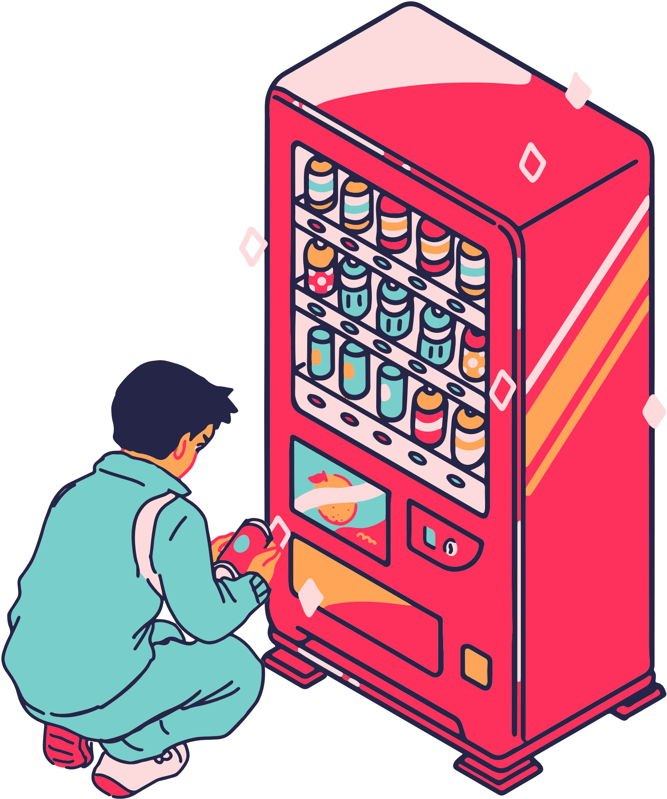
EC 202 Presentation
VENDING MACHINE
Sahitya Kushwaha (623195)
Prasastha Datla (623157)
Ganti Dheeraj (623192)

Slide 2
Main Components
Debounce Module
Slow Clock Generator
Flip-Flop Module
Binary to BCD Converter
7-Segment Driver and Decoder
Vending Machine

Slide 3
Top Module
Module: Top_Module
Inputs: clk, reset, btn1, btn2, btn3, sw[7:0]
Outputs: led, seg, an, dp
Description: Integrates all submodules and connects signals for the vending machine functionality

Slide 4
Debounce Module
Purpose: Debounce button signals to avoid erroneous inputs.
Inputs/Outputs:
Inputs: clk_in, pb
Outputs: led
Working:
Uses a 4 Hz slow clock and two D flip-flops to debounce the input.

Slide 5
Slow Clock 4Hz Module
Purpose: Generate a 4 Hz clock signal from the input clock.
Inputs/Outputs:
Input: clk_in
Output: clk_out
Description:
Counts up to 12,500,000 to toggle clk_out at 4 Hz.

Slide 6
Flip-Flop Module
Purpose: Basic D flip-flop with output and complemented output.
Inputs/Outputs:
Inputs: clk, D
Outputs: Q, Qbar

Slide 7
Binary to BCD Converter Module
Purpose: Convert a 12-bit binary number to BCD format.
Inputs/Outputs:
Input: binary[11:0]
Outputs: thos, hund, tens, ones
Operation: Divides and finds the remainder to convert binary to decimal.

Slide 8
7-Segment Driver Module
Purpose: Display BCD digits on a 7-segment display.
State Machine: Cycles through four states to display each digit.
Code Overview:
Inputs: clk, clr, BCD digits
Outputs: seg, an, dp

Slide 9
7-Segment Decoder Module
Purpose: Display each digit on a 7-segment display.
State Machine: turns on the LEDs to display corresponding digits on screen
Code Overview:
Inputs: clk, clr, BCD digits
Outputs: seg, an, dp

Slide 10
Vending Machine Module
Purpose: Handles vending operations and tracks money and stock.
Inputs/Outputs:
Inputs: clk, reset, twenty, fifty, select, buy, load
Outputs: money, products, out_of_stock
Key Operations:
Accepts money, handles purchases, and manages stock.

Slide 11
Conclusion
Discussed the integration of all modules to form a complete vending machine system
Open for any questions.

Slide 12
Further Improvements
1. Commercialization and Real-world Application
Prototype for Production: Develop a physical prototype to demonstrate the feasibility of deploying the system in real-world vending machines.
2. Robotic Dispensing System
Dual Dispenser: Allow simultaneous dispensing of different types of products for faster service.
adding more no. of products

Slide 13
THANK YOU

